Slide 1
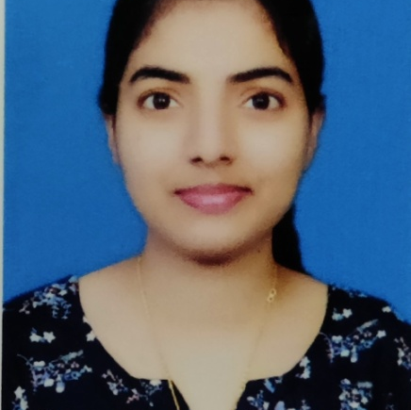


AHAMED UNNISA
Analyst/Software Engineer
BACHELOR OF TECHNOLOGY
Computer Science :2016-2020
Skills Java 8
Spring Boot
Spring MVC
MERN Stack
NodeJS
MongoDB
DatabaseL
No SQL database – MongoDB
Web Technologies
HTML5
CSS3
Javascript
AddOns
Github
Maven
Postman
Additional skills
Leadership Qualities
Quick Learner
Team Management
BANGALORE
AHAMED.UNNISA@CAPGEMINI.COM
+91 9640873034
A4
Eager to work in a team of dedicated people and serve a key role in the enhancement and development of the project.
Software Engineer who is Strong in design and integration with intuitive problem-solving skills. Passionate about implementing and launching new projects.
Ready to learn new technologies and implement them to further improve my knowledge.
Has working knowledge on Angular and Java Microservice Development using Spring framework on an intermediate level.
Online Railway Reservation :
Completed end to end case study of Online Railway Reservation along with JWT authentication, Swagger and payment testing. Material-UI and ANGULAR used for user interface.
HTML CSS JAVASCRIPT for web developers at DEGREED
Completed this course with 95% and Designed responsive Restaurant website using HTML5 CSS3 ANGULAR
https://github.com/AhamedUnnisa?tab=repositories
https://github.com/AhamedUnnisa/Architecture-Diagram.git
Check out my work on GitHub & Video Profile

